Slide 1


Slide 2

ourworldindata.org

Slide 3


Slide 4


Slide 5
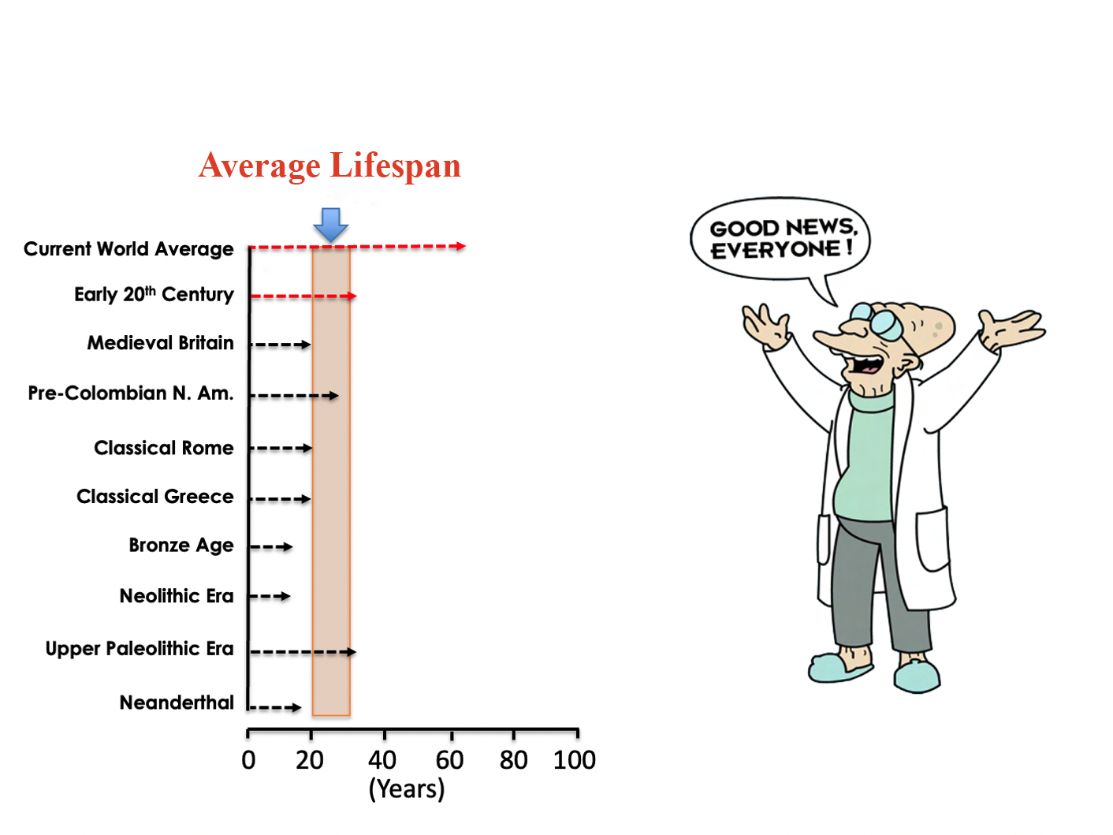

Slide 6


Slide 7
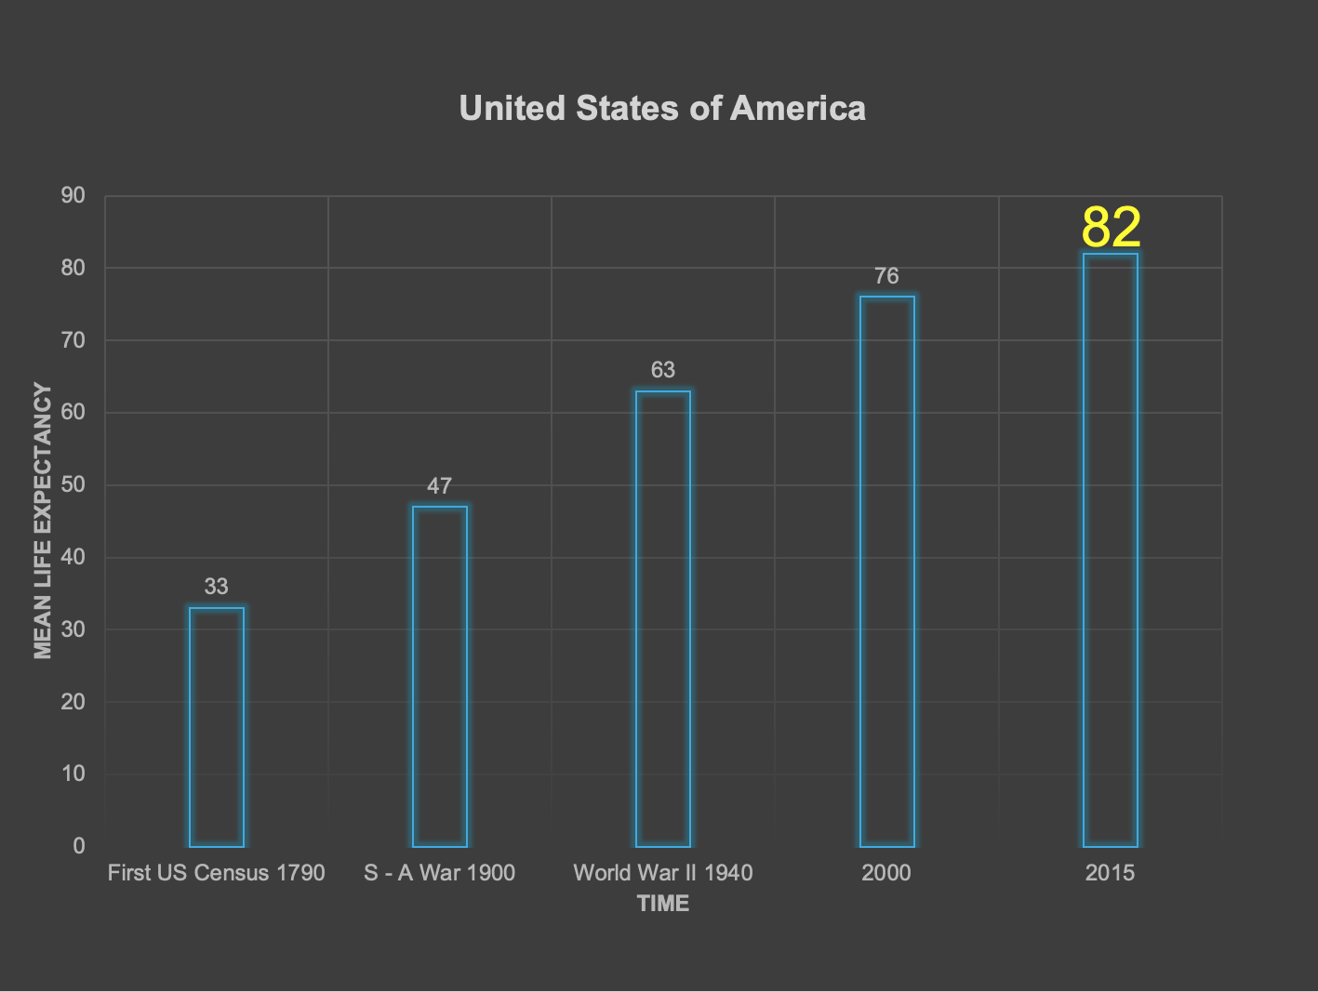

Slide 8
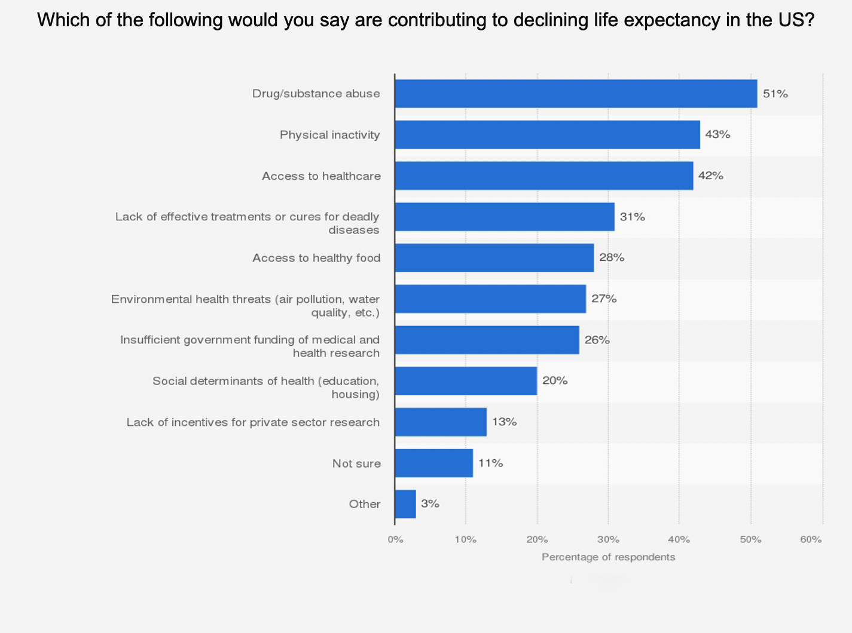

Slide 9


Slide 10
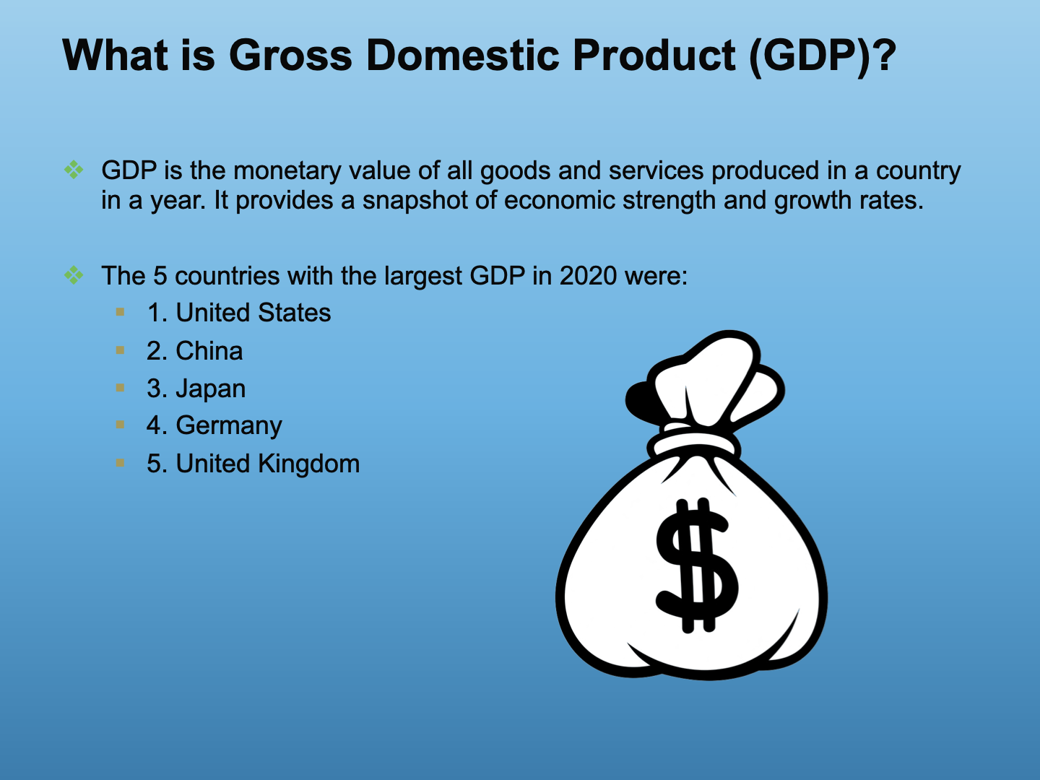

Slide 11

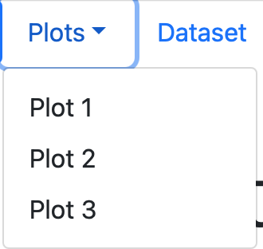


Slide 12


Slide 13
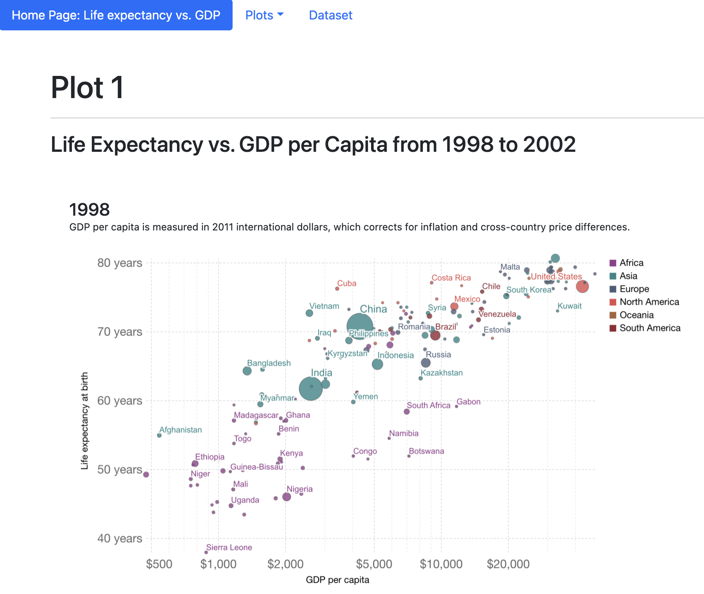

Slide 14
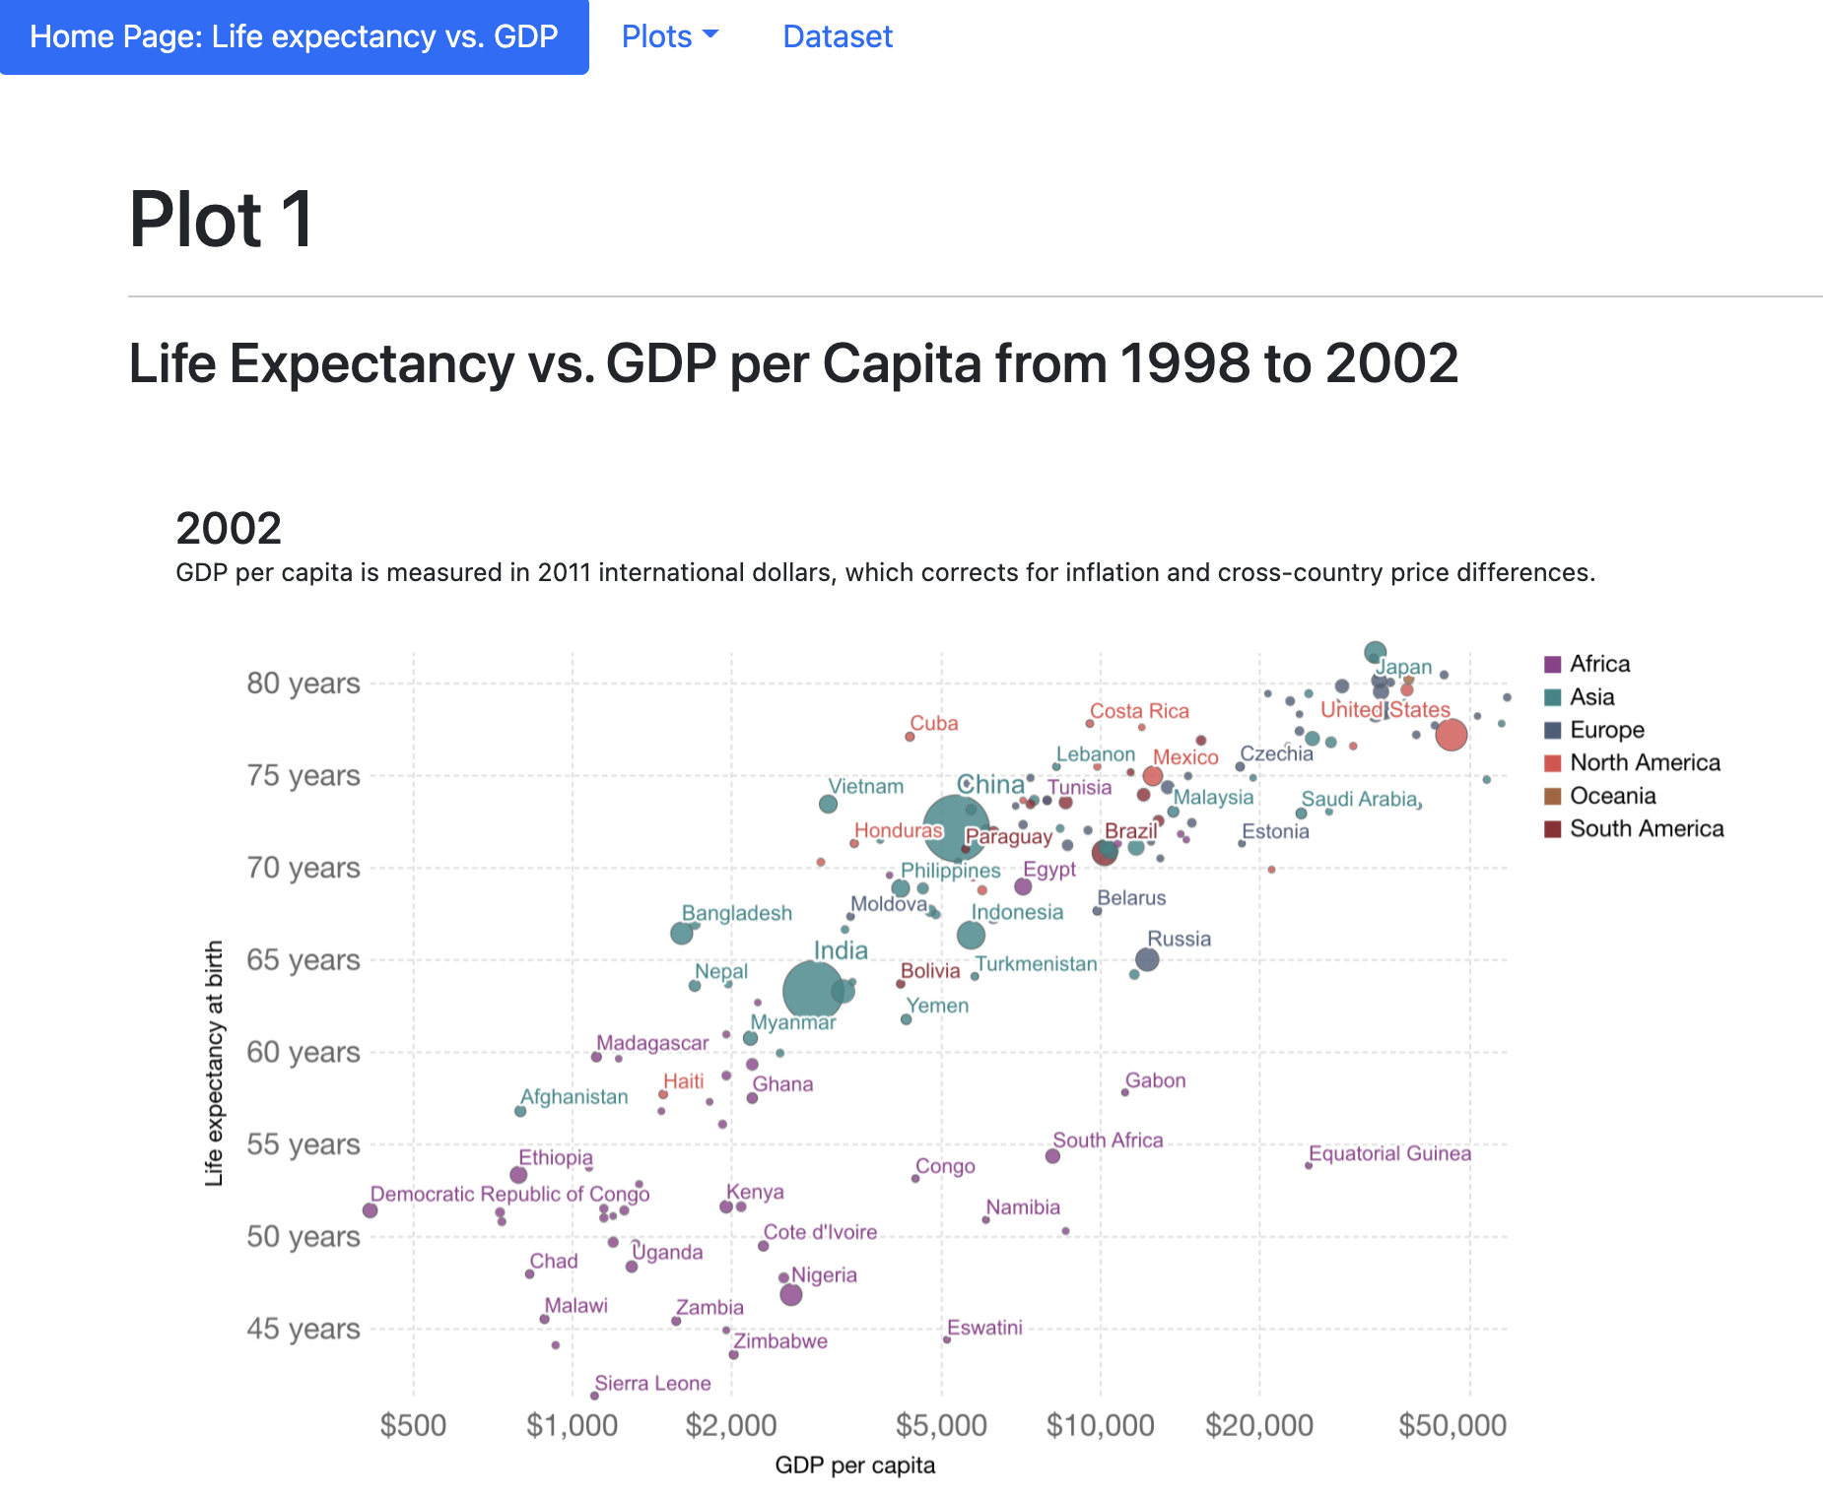

Slide 15
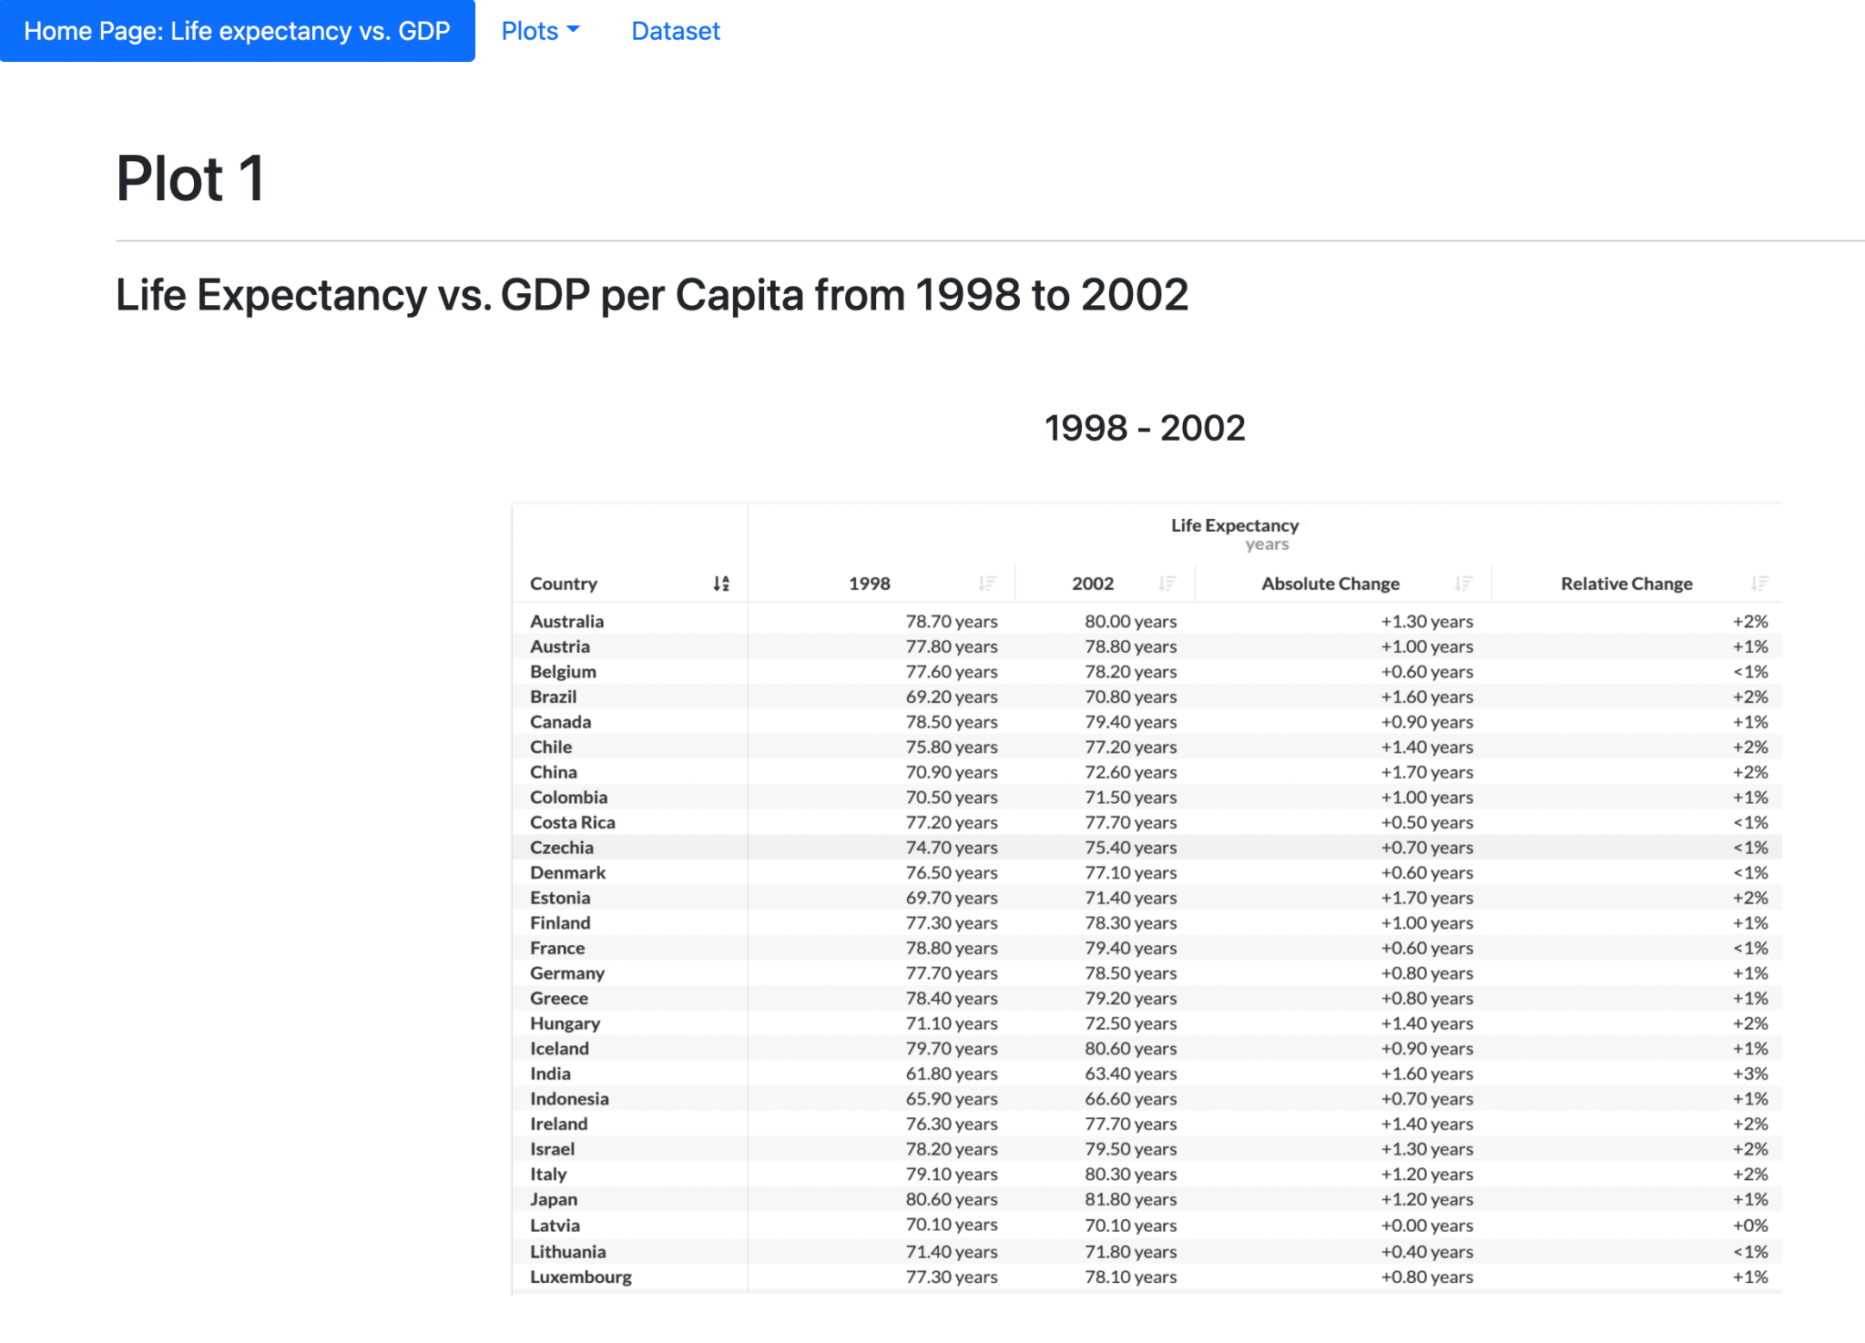

Slide 16
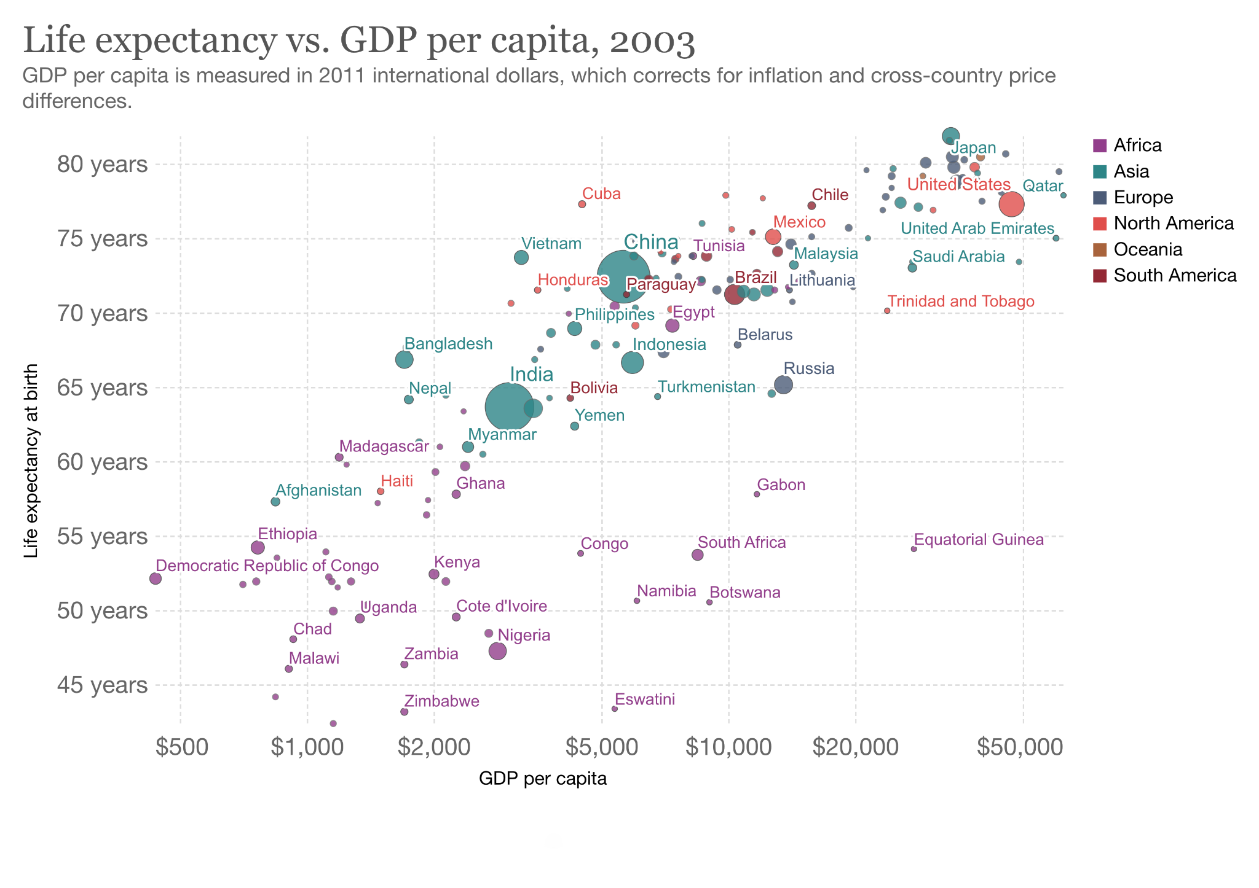

Slide 17
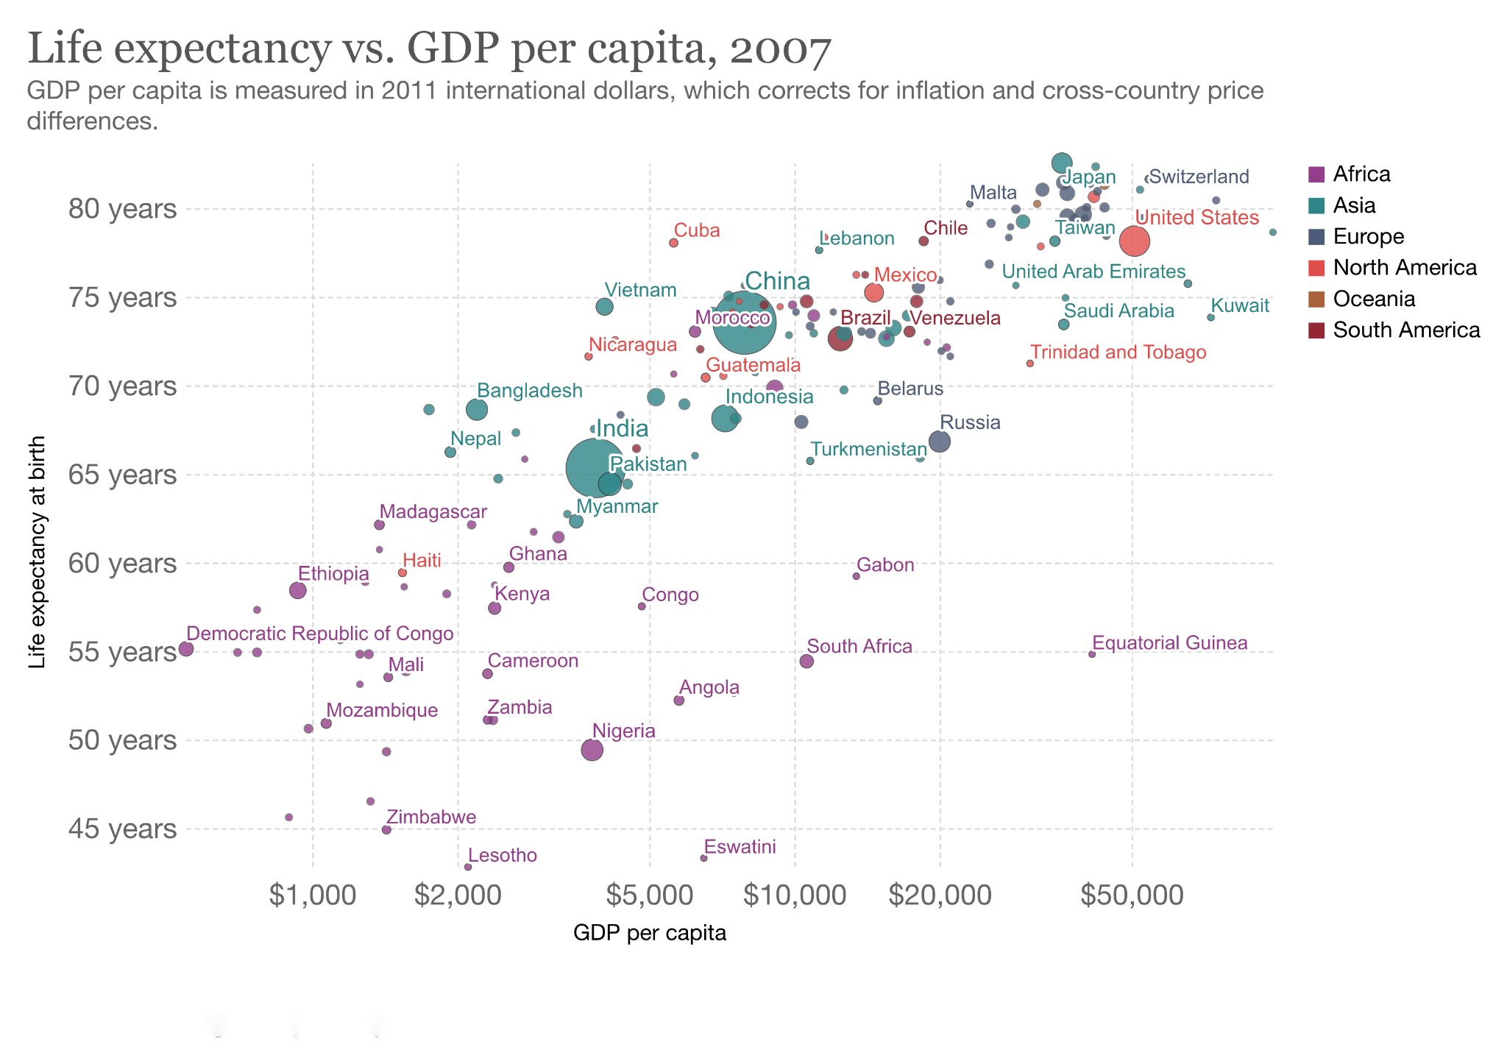

Slide 18
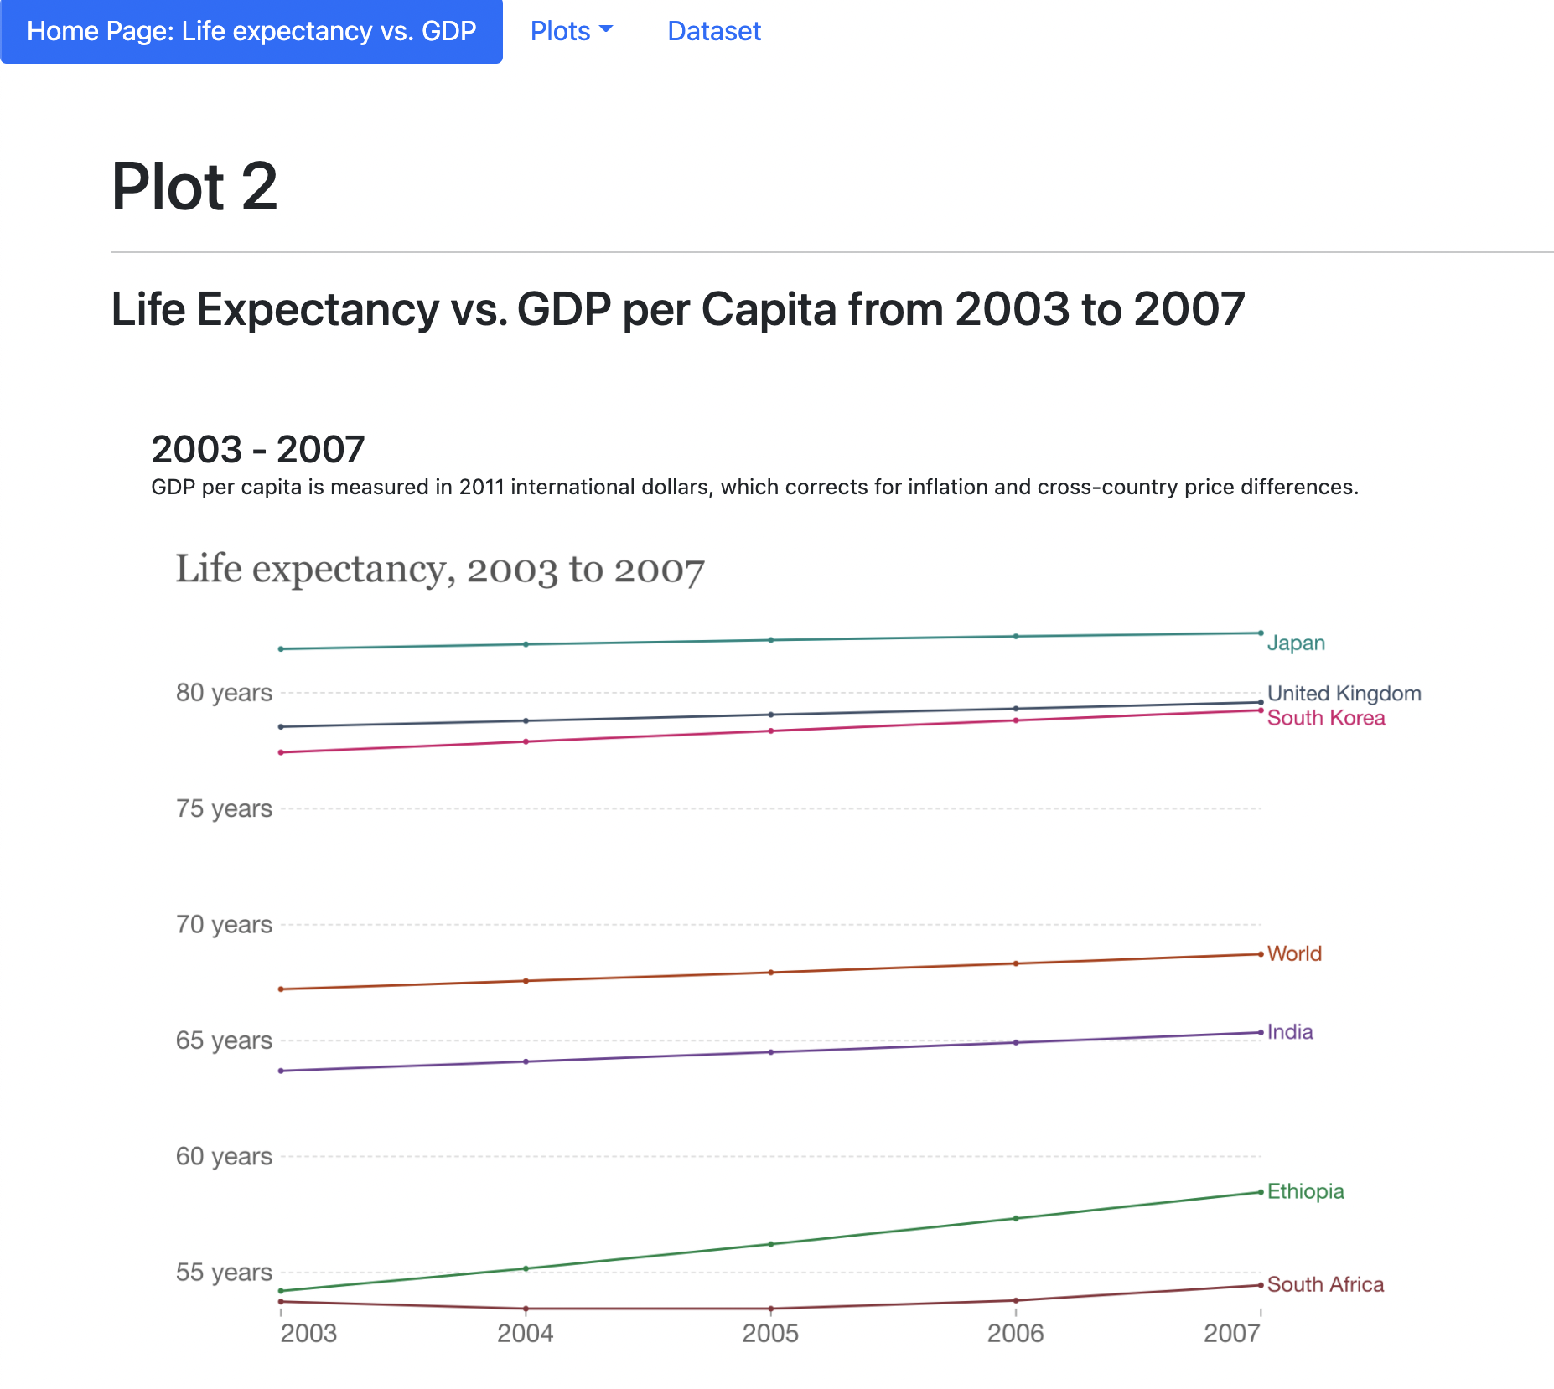

Slide 19
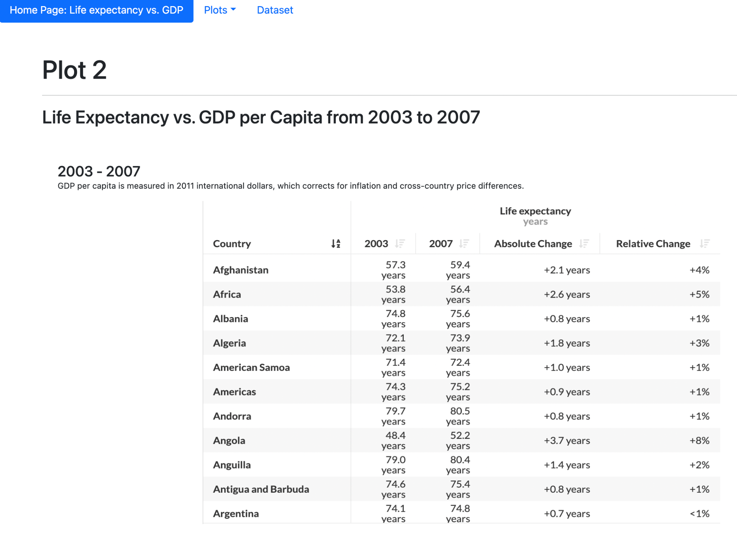

Slide 20
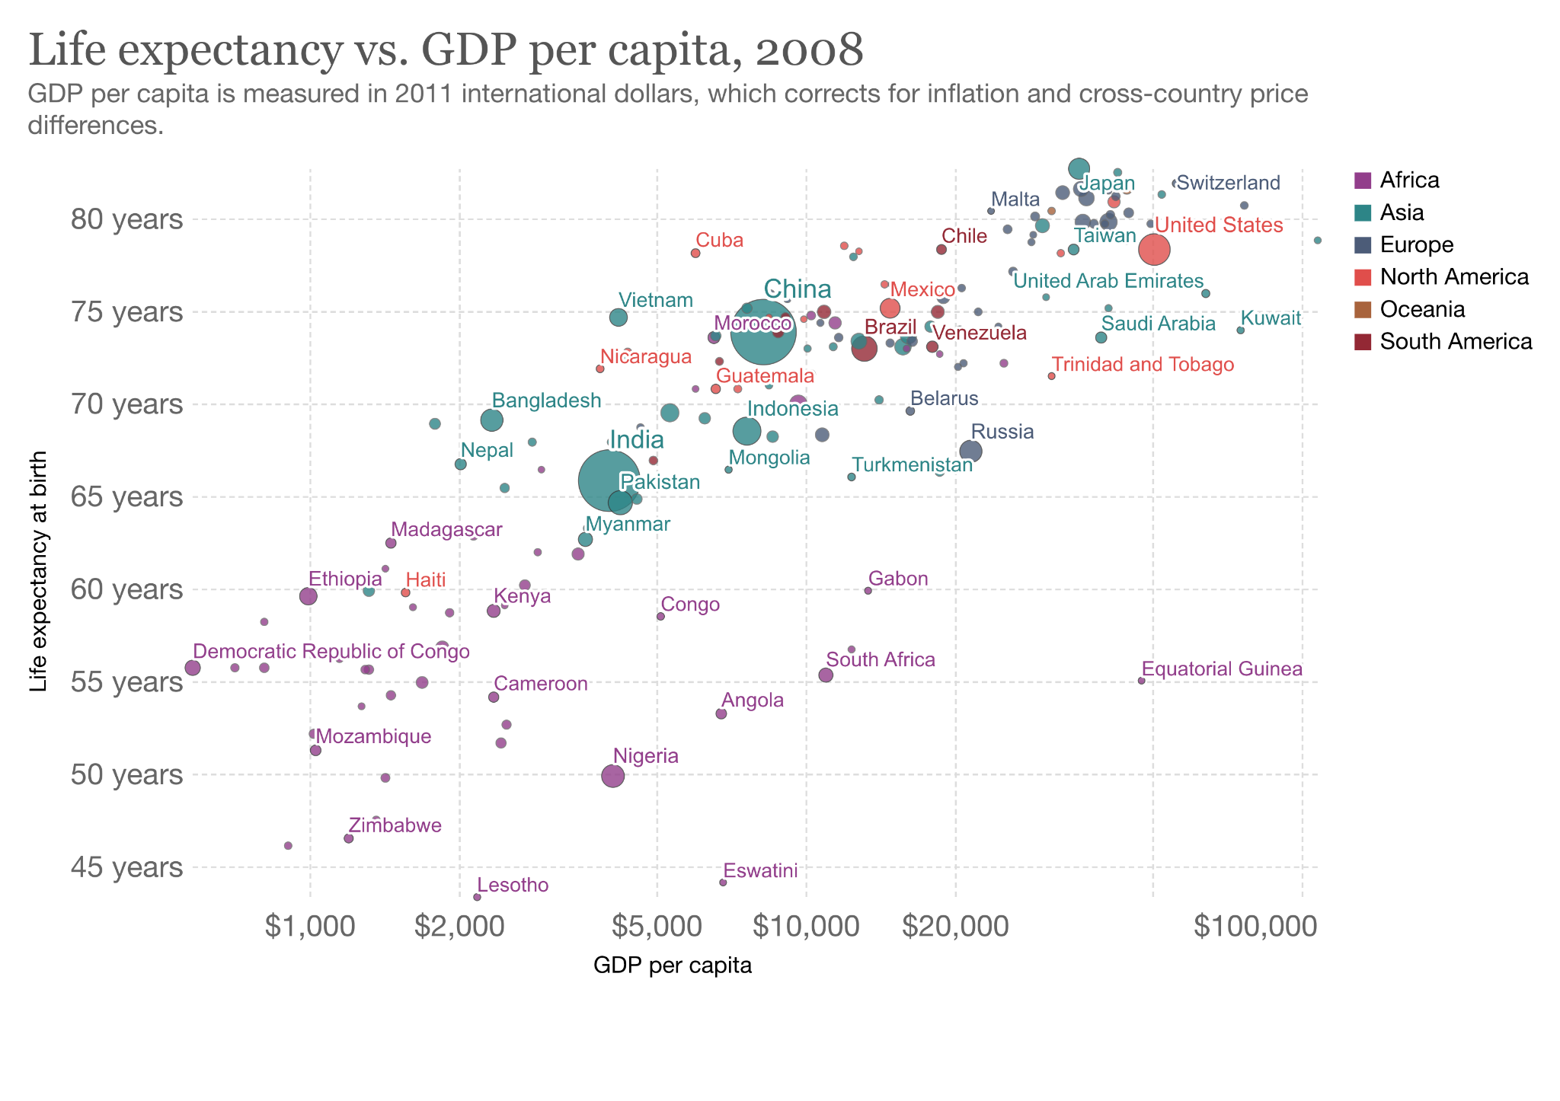

Slide 21
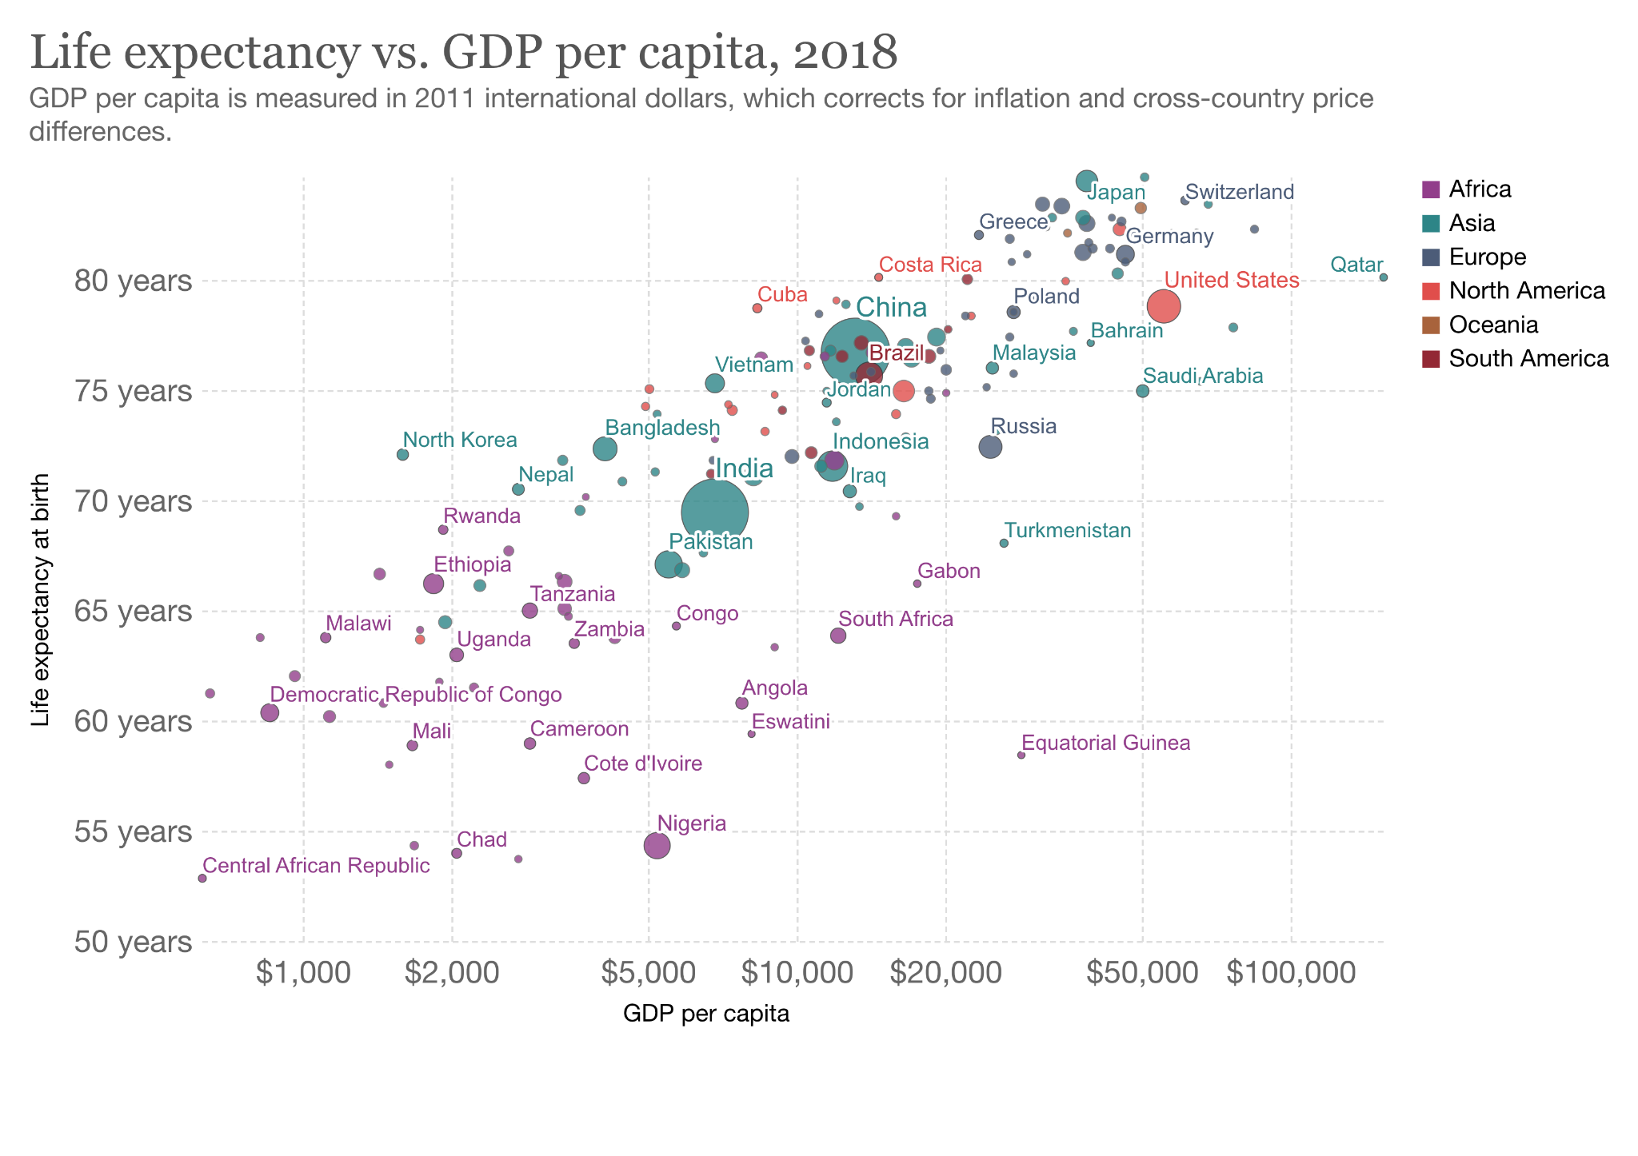

Slide 22
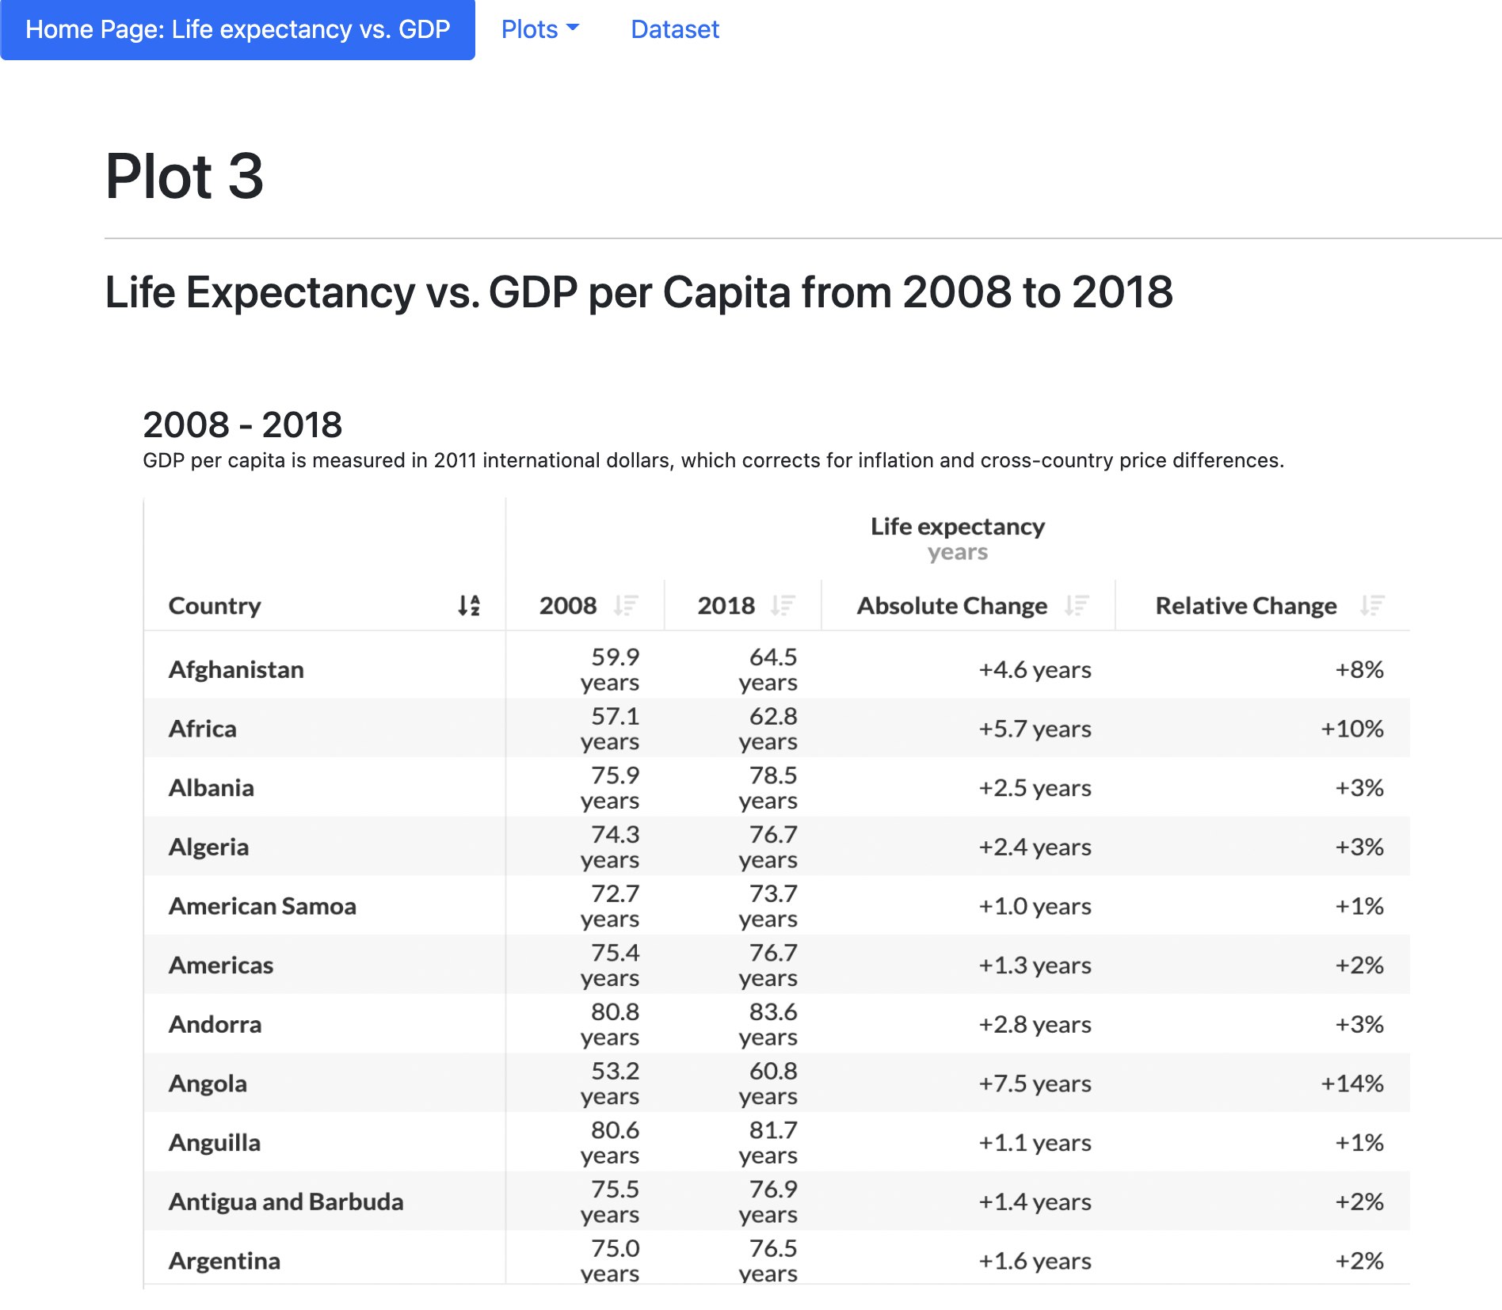

Slide 23
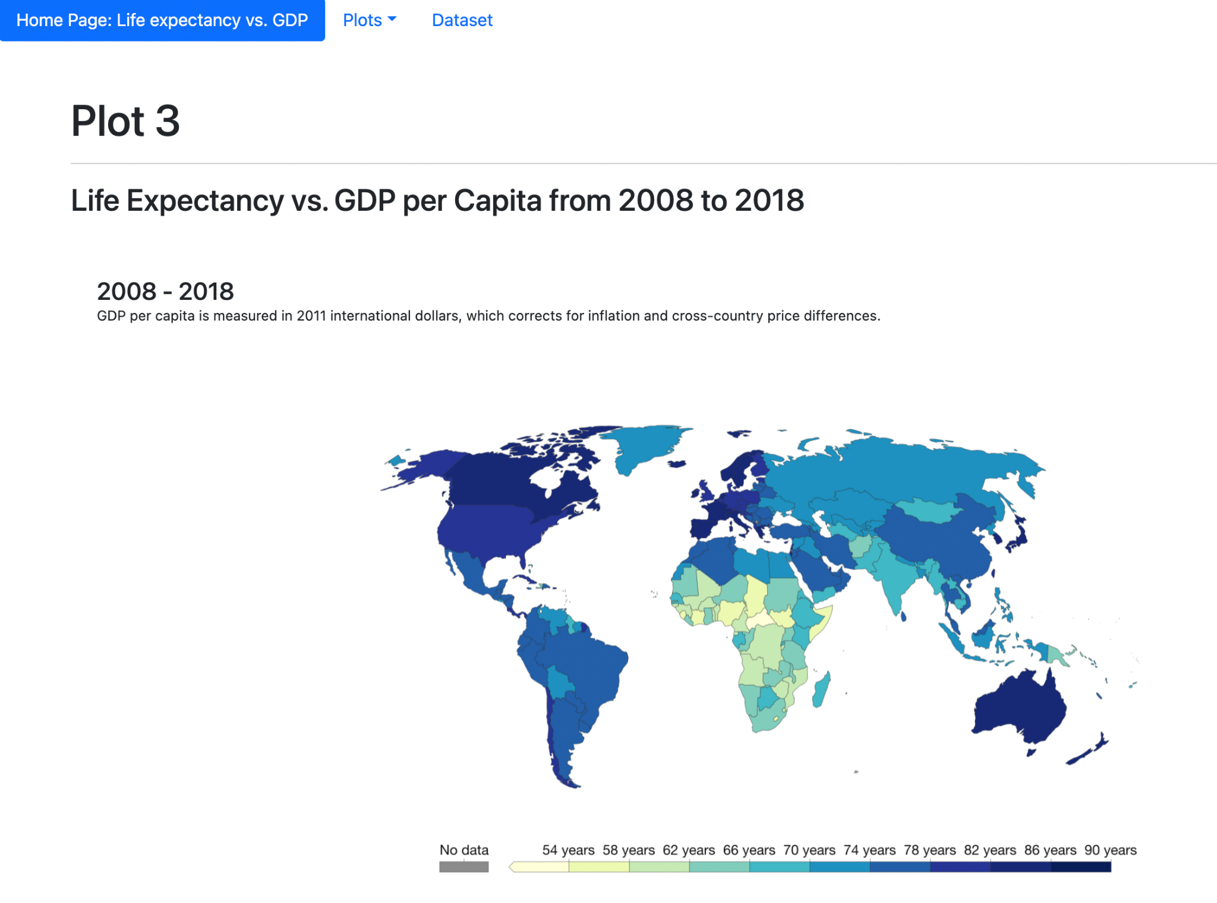

Slide 24


Slide 25
GDP per capita and Life Expectancy have a strong correlation between the two variables
The higher the GDP per capita, the higher is the Life Expectancy
GDP per capita increases the life expectancy
Countries with higher GDP tend to have higher life expectancy
The Preston Curve generally applies to GDP per capita and life expectancy, but does not account for instances such as war and epidemics

Slide 26


